Slide 1
Anatomy and Physiology of Performance Anxiety
Dr. Laura Grantier

Slide 2
Agenda
What is performance anxiety?
The Central and Peripheral Nervous System
The Sympathetic and Parasympathetic Nervous System
Physiology of “Fight or Flight”
Questions?

Slide 3
Introduction
Stress and anxiety about performing in front of people causes performance anxiety. Confronting your fears and vulnerabilities, accepting yourself for who you are, and not feeling like you have to prove yourself to others, is the first step toward overcoming performance anxiety. Keep in mind that nobody is perfect, nobody expects you to be perfect, and it is OK to make mistakes.

Slide 4
Symptoms of Performance Anxiety
Racing pulse and rapid breathing
Dry mouth and tight throat
Trembling hands, knees, lips, and voice
Sweaty and cold hands
Nausea and an uneasy feeling in your stomach
Vision changes

Slide 5
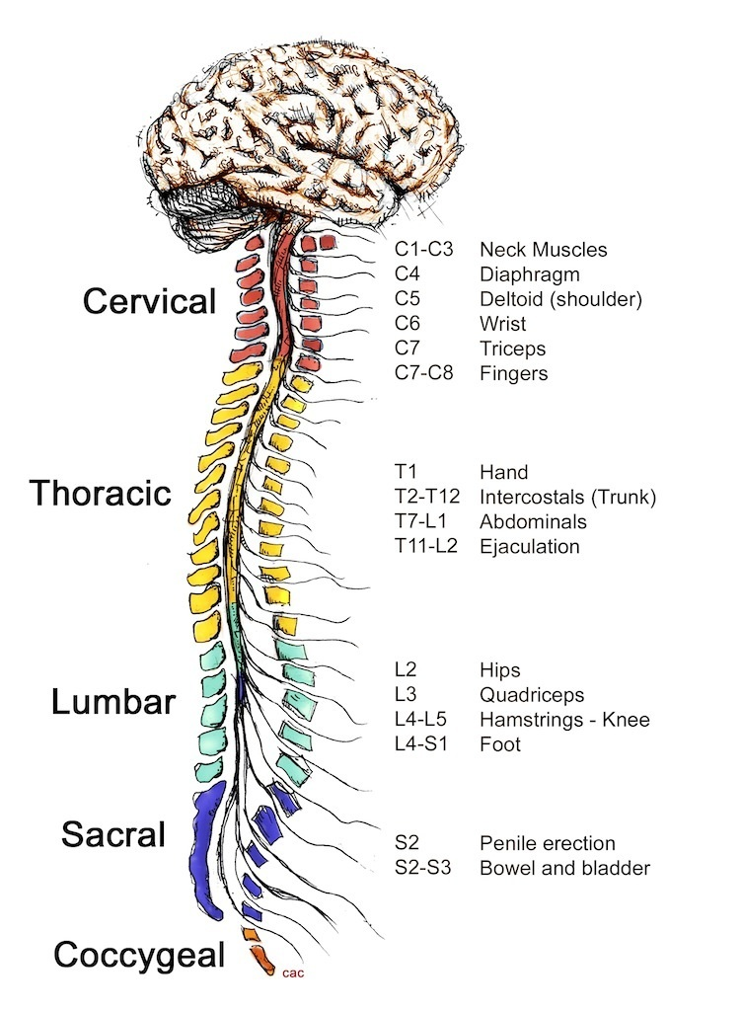
The Central and Peripheral Nervous System

Slide 6
The nervous system can be divided into two major regions: the peripheral nervous system and the central nervous system.
The central nervous system also known as the CNS consists of the brain and spinal cord. The spinal cord transmits information for the brain to process. The brain is contained within the cranial cavity of the skull, and the spinal cord is contained within the vertebral cavity of the vertebral column.
The peripheral nervous system consists of everything else. It has been compared to the power plant of the nervous system. It is like a system that collects information and sends commands.
The PNS is also divided into two systems, the autonomic nervous system and the sensory-somatic nervous system.
The peripheral nervous system is so named because it is on the periphery—meaning beyond the brain and spinal cord

Slide 7
The Automatic Nervous System

Slide 8
Your autonomic nervous system lies almost entirely outside of the central nervous system and involves two main parts: the craniosacral part (parasympathetic), and the thoracolumbar part (sympathetic). These are sometimes thought of as being opposite to each other, ultimately striking a balance within the body.
The parasympathetic is associated with relaxation, digestion, and generally taking it easy.
The sympathetic is responsible for the "fight or flight" response.
One of the interesting things about the autonomic nervous system is that, almost without exception, the nerves synapse in a clump of nerves called a ganglion before the message is transmitted to the target organ, such as a salivary gland. This allows for another level of communication and control.

Slide 9
https://video.search.yahoo.com/search/video?fr=mcafee&ei=UTF-8&p=how+to+managing+the+sympathetic+nervous+system+in+stage+fright+management&type=E211US714G0#id=7&vid=e8147736bb790a53c8b0fc5f40185f8f&action=view Fight or Flight Video

Slide 10
Limit caffeine and sugar intake the day of the performance. Eat a sensible meal a few hours before you are to perform so that you have energy and don't get hungry. A low-fat meal including complex carbohydrates -- whole-grain pasta, lentil soup, yogurt, or a bean and rice burrito -- is a good choice.
Shift the focus off yourself and your fear to the enjoyment you are providing to the spectators. Close your eyes and imagine the audience laughing and cheering, and you feeling good.
Don't focus on what could go wrong. Instead focus on the positive. Visualize your success.
Avoid thoughts that produce self-doubt.
Be prepared: practice, practice, practice.
Practice controlled breathing, meditation, and other strategies to help you relax and redirect your thoughts when they turn negative. It is best to practice some type of relaxation technique every day, regardless of whether you have a performance, so that the skill is there for you when you need it.
Take a walk, jump up and down, shake out your muscles, or do whatever feels right to ease your anxious feelings before the performance.
Connect with your audience -- smile, make eye contact, and think of them as friends.
Act natural and be yourself.
Exercise, eat a healthy diet, get adequate sleep, and live a healthy lifestyle.
Keep in mind that stage fright is usually worse before the performance and often goes away once you get started.

Slide 11
Questions?
Thank you!

